Slide 1
Story Board
Rozan Youssef Al Majzoub

Slide 2
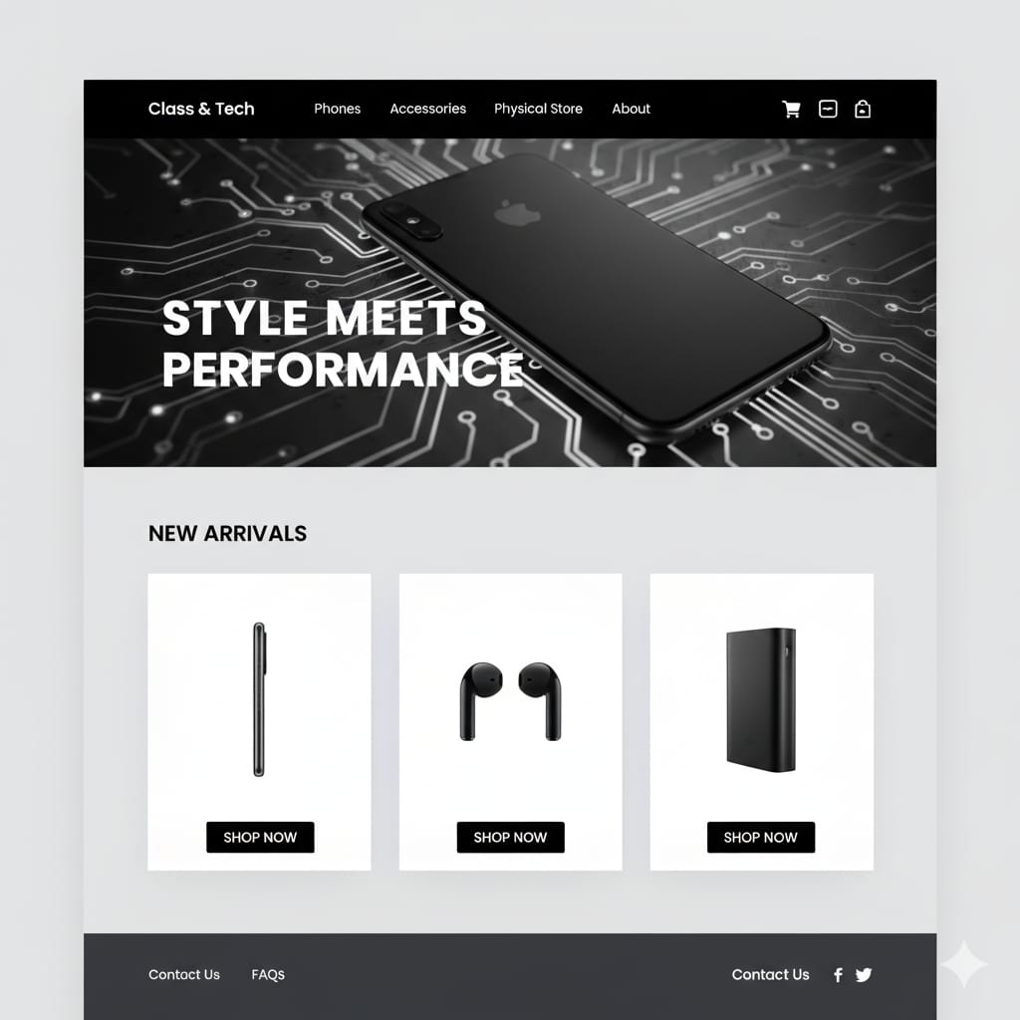
Homepage

Slide 3
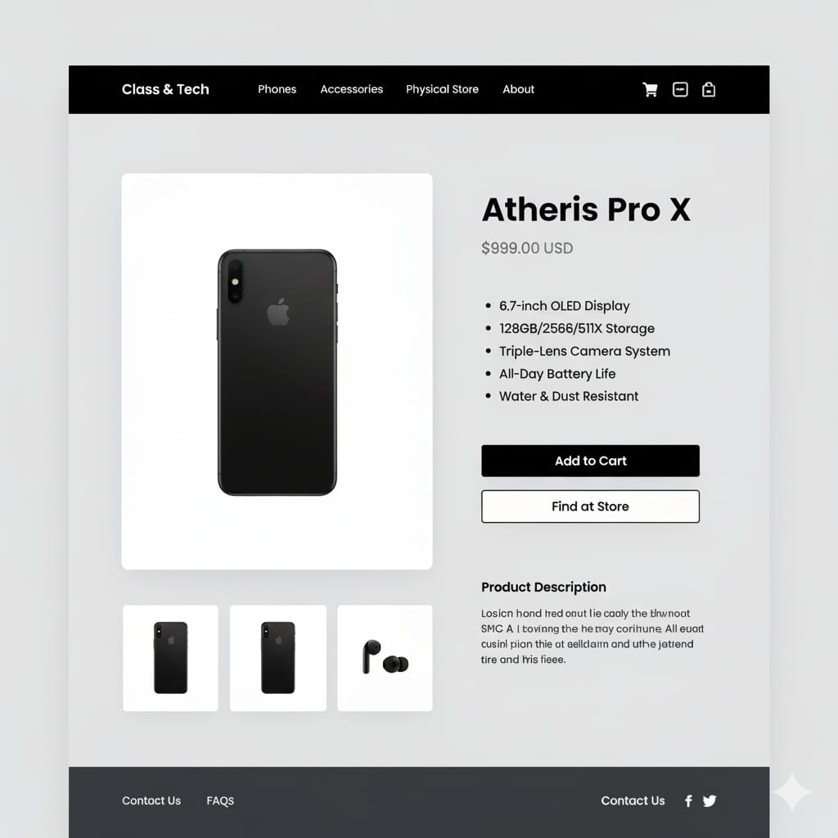
Products page

Slide 4
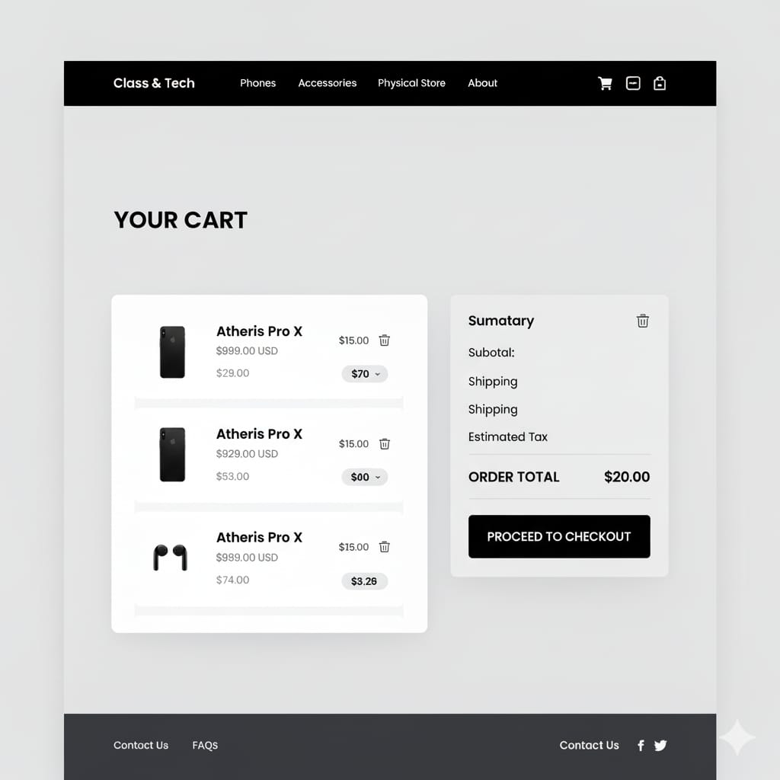
Cart

Slide 5
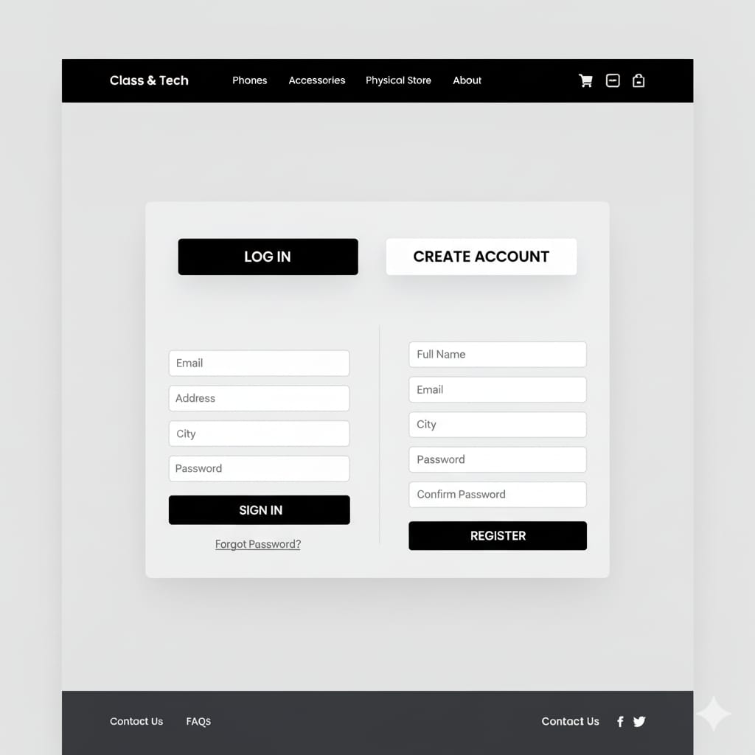
Login / registration forms

Slide 6
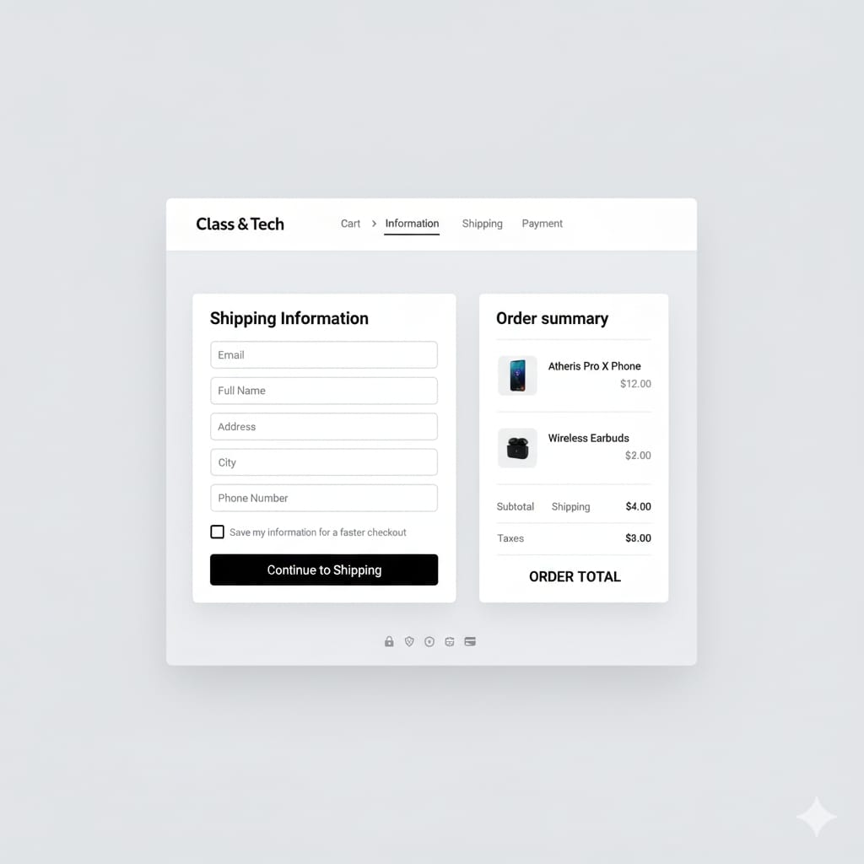
Checkout

